Slide 1
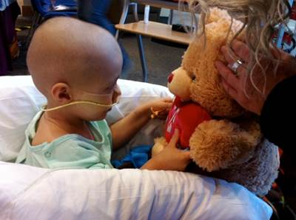
The Pediatric Chaplains Institute is a seven-week course of instruction for professional chaplains who are new to the pediatric clinical setting.

Slide 2
What is the Pediatric Chaplains Institute (PCI)?
A seven week education program in pediatric chaplaincy
Weeks 1-6: Online learning environment, 2-4 hours/week of time spent reading and participating in online assignments.
Week 7: Onsite, in person gathering at Children’s National – Washington, D.C. for intensive learning to integrate and practice online learning, and explore other concerns in pediatric spiritual care.
Results in ability to articulate and demonstrate the knowledge and skills needed to confidently care for children and their families.
Students are expected to participate in the entire 7 week program.

Slide 3
When and Where is PCI?
When:
Online Modules: Week 1 begins August 14, 2017, continues weekly
Intensive Gathering: October 1 (Sunday Evening) – October 6(Friday – Noon).
Where:
Intensive will be hosted at Children’s National
Health System in Washington, D.C.
(October 1 – 6, 2017)

Slide 4
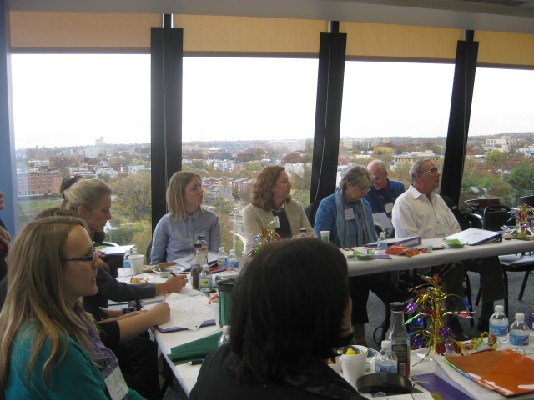
What do I Need to Know?
The PCI is not a conference. It is a course of training in the specialized work of providing pastoral/spiritual care to pediatric patients and their families.
As a student you will be provided a wealth of take-home information, including full access to the online learning modules that are the backbone of the Institute.
The 2016 PCI is the Institute's Tenth Training.
Through 2016,
126 chaplains from 65 different institutions,
28 states, the District of Columbia, and 1 Canadian province
have attended the PCI.

Slide 5
Learning and Integration
PCI utilizes many teaching/learning styles; we realize that the on-line learning process is not optimum for all. However, we make use of this method in order to maximize the time and facilitate multiple learning processes during our intensive week together.
Weekly modules include multi-media learning, concluding with a brief assignment meant to foster reflection on the learning. These assignments will also become a portion of our first day’s curriculum during Intensive in November. Students will be given clear written directions to access and use the site; as well, faculty are available to provide help as needed.
A very important aspect of the training is the support of students’ supervisors. Each supervisor will receive a contact from the Dean of the Institute thanking them for sponsoring a student’s participation and encouraging them to provide work time to complete the six-week preliminary education.

Slide 6
How do I Sign Up?
Cost:
Tuition for the seven-week PCI course is $1,000
Hotel and Travel expenses (to/from) are the responsibility of the sending institution or student and are not covered in tuition.
Some tuition scholarships are available thanks to a very generous grant from the Wilbert Foundation.
Applications may be found here (www.pediatricchaplains.org)
Our experience to date indicates that students find the Institute extremely valuable in preparing them for their work in a pediatric setting. We work hard – but always have fun!
Learning is multifaceted. Each year the curriculum presents new levels of depth and breadth – and each year’s students bring their own particular insights.
We hope you will join us in 2017!

